Slide 1
Final Projects
Lesson 11.1

Slide 2

We are almost there...
Notes:
shutterstock_304864298

Slide 3
Look at all you have learned!
The Browser HTML CSS JavaScript jQuery Bootstrap | Dev Tools Heroku Git GitHub | Server Side Templating Engines Sessions Writing tests Node.js Express.js Creating APIs MVC User Authentication ORM (Sequelize)
API Interaction APIs JSON AJAX Real Time Cloud Database via Firebase | Databases MySQL MongoDB
Cutting Edge Development React.js |  | CS Fundamentals Algorithms Data Structures

Slide 4
Your Goals Re-examined
And why do you want a new career?
To pursue a dream
To escape a dead-end job
To be able to create
To follow a fascination
To attain financial stability
To obtain financial freedom
To challenge yourself
To be a role model to kids

Slide 5
What’s Left
Final Projects
Remaining Topics: Computer Science Algorithms, Javascript Design Patterns
Lightning Talks
Job Workshops
Demo Day!

Slide 6
Never Stop Learning!
The key to hireability and relevance is to constantly be learning.
The field is always changing and there is never a point where you can call it quits.
Stick with it! It’s a craft that you continue to hone with time.

Slide 7
Final Projects

Slide 8
Your Challenge

Slide 9


Your Challenge
You have plenty of time to work on this.
You have ALL the skills you need.
You have a team of skilled developers.
You have experts willing to help.
No excuses. Time to prove yourself.

Slide 10
Expectations

Slide 11
Expectations
We expect whatever you build to have utility.
We expect you to have market or real-world research that evidences your idea has REAL value to people.
We expect you to have done research on other web/mobile applications in your domain.
We expect you to put serious time and thought into this.
We expect you to report problems you are facing along the way.
We expect you to utilize some form of project management system.
We expect you to dig deep into documentation and external resources to learn what you need.

Slide 12
Requirements

Slide 13
Coding Requirements
Must use ReactJS in some way (even if minimal)
Must use a Node and Express Web Server
Must be backed by a MySQL or MongoDB Database with a Sequelize or Mongoose ORM
Must have both GET and POST routes for retrieving and adding new data
Must be deployed using Heroku (with Data)
Must utilize at least two libraries, packages, or technologies that we haven’t discussed
Must allow for or involve the authentication of users in some way
Must have a polished frontend/UI
Must have folder structure that meets MVC Paradigm
Must meet good quality coding standards (indentation, scoping, naming)
Must not expose sensitive API key information on the server

Slide 14
Deliverables

Slide 15
Deliverables
Instead of homework, you will be required to submit four Project Deliverables.
Plan, Design, and Research
Ready MVP (Working App!), Mini-Presentation
Project Polish, Functionality Push, Final Plan
Presentation Time!

Slide 16
Deliverables 1: Plan, Design, and Research

Slide 17
Deliverables 1: Plan, Design, and Research
In this plan, you will include:
An overview of the intended application and WHY you feel it’s valuable.
A set of DETAILED screen-by-screen design layouts with annotations describing all UI/UX components and all data relevant to the screen.
A breakdown of roles by group member.
A schedule for completion of various tasks.
A screenshot of your Project Management Board that shows breakdown of tasks, assigned to group members with a schedule.

Slide 18
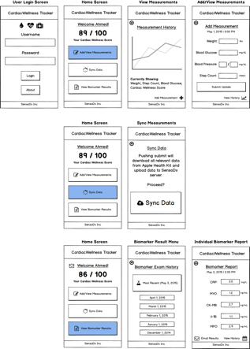
Example UI/UX Flow
Screen Map
This is intended to show you the order in which users would see screens. The three branches correlate with the three button options from the main menu.

Slide 19
Example Data Flow
User View—Clinical Trial App
User Login
(Username, Password)
Add Weekly Measurement (Self-Reporting)
Sync Weekly Measurement (Sensors)
View Biomarker Results
User Health Data
Weight
Blood Pressure
Blood Glucose
Steps Walked
Deliver to Cloud

Slide 20
Groups
Groups:
Group 1 - Alejandro, Henry, Lillie, Nancy
Group 2 - Alys, Austin, Christopher, Mikey, Randon
Group 3 - Chad, Jonah, Lougine
Group 4 - Joshua, Tai, Tom, Yasi

